Slide 1
SE 181 UML Sequence Diagrams

Slide 2
Introduction to Sequence Diagrams
Sequence diagrams:
illustrate how objects interact with each other.
focus on message sequences, that is, how messages are sent and received between a number of objects.
have two axes:
the vertical axis shows time and,
the horizontal axis shows a set of objects.

Slide 3
Sequence Diagrams
A sequence diagram can be used to reveal the interaction for a specific scenario—a specific interaction between the objects that happens at some point in time during the system’s execution (for example, when a specific function is used).
Sequence diagrams can also be used to model the high-level interaction between subsystems.

Slide 4
Example
customer
ATM
Insert card
Prompt a text field for PIN
Input the PIN
…
Show account summary

Slide 5
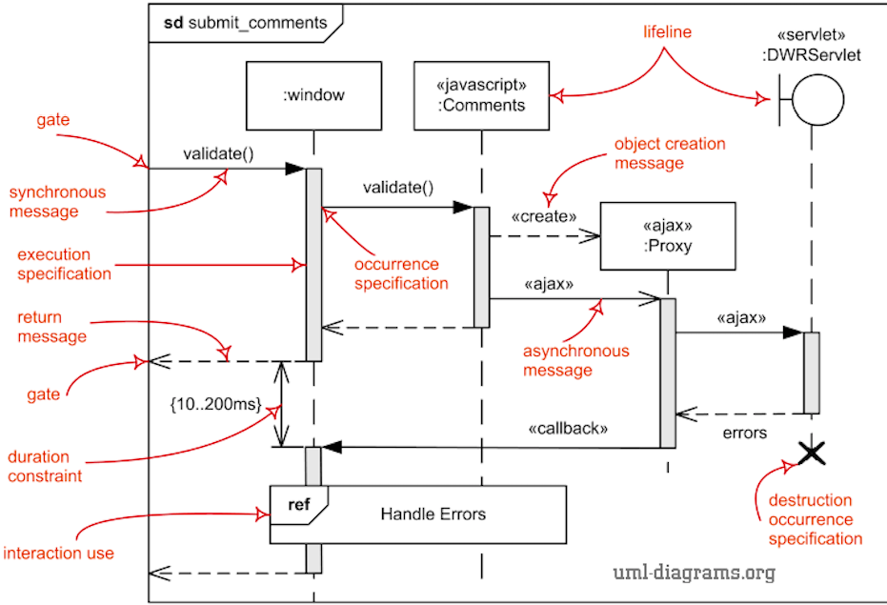
Sequence Diagram Notations

Slide 6
Lifelines
On the horizontal axis of a sequence diagram are the objects involved in the sequence.
Each is represented by an object rectangle with the object and/or class name.
The rectangle along with the vertical dashed line, called the object’s lifeline, indicates the object’s execution during the sequence (that is, messages sent or received and the activation of the object).
object name

Slide 7
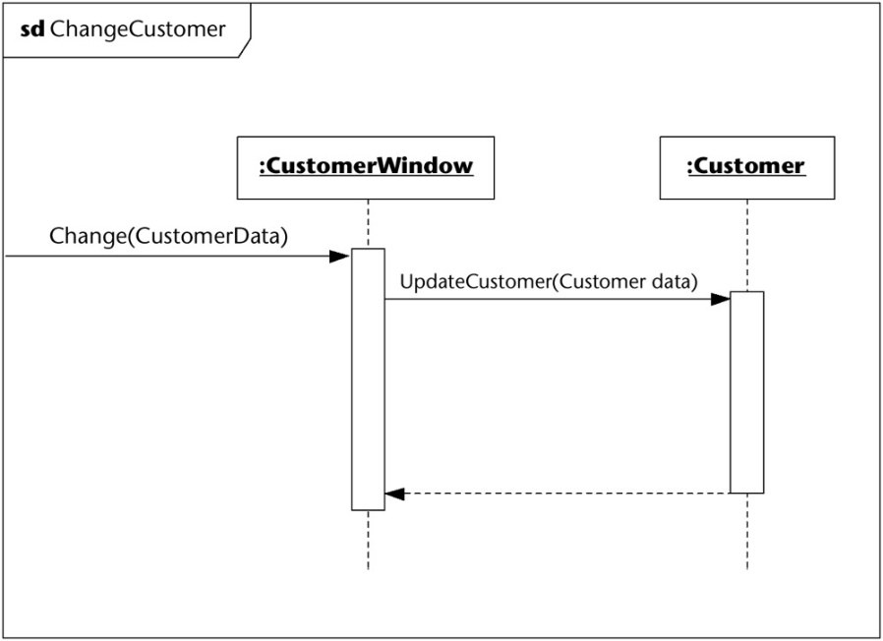
Messages
Communication between the objects is represented as horizontal message lines between the objects’ lifelines.
To read the sequence diagram, start at the top of the diagram and read down to view the exchange of messages taking place as time passes.

Slide 8
Messages (cont’d)
Synchronous: a message is sent by one object to another and the first object waits until the resulting action has completed.
Asynchronous: a message is sent by one object to another but the first object does not wait until the resulting action has complete, it carries on with the next step in its own sequence of actions.
synchronous
asynchronous

Slide 9
Messages (cont’d)
Creation: represents a message that causes the creation of an object instance to which the message is sent.
Reply: represents the explicit return of control from the object to which the message was sent.
creation
reply

Slide 10
Focus of Control or Execution Occurrence
A message arrow is usually shown going from the execution occurrence region (focus of control) of the sending object to the execution occurrence region of the receiving object.
The execution occurrence is shown as a narrow rectangle placed over the lifeline of an object.
The execution occurrence indicates which object is currently controlling the synchronous interaction.
object
object

Slide 11
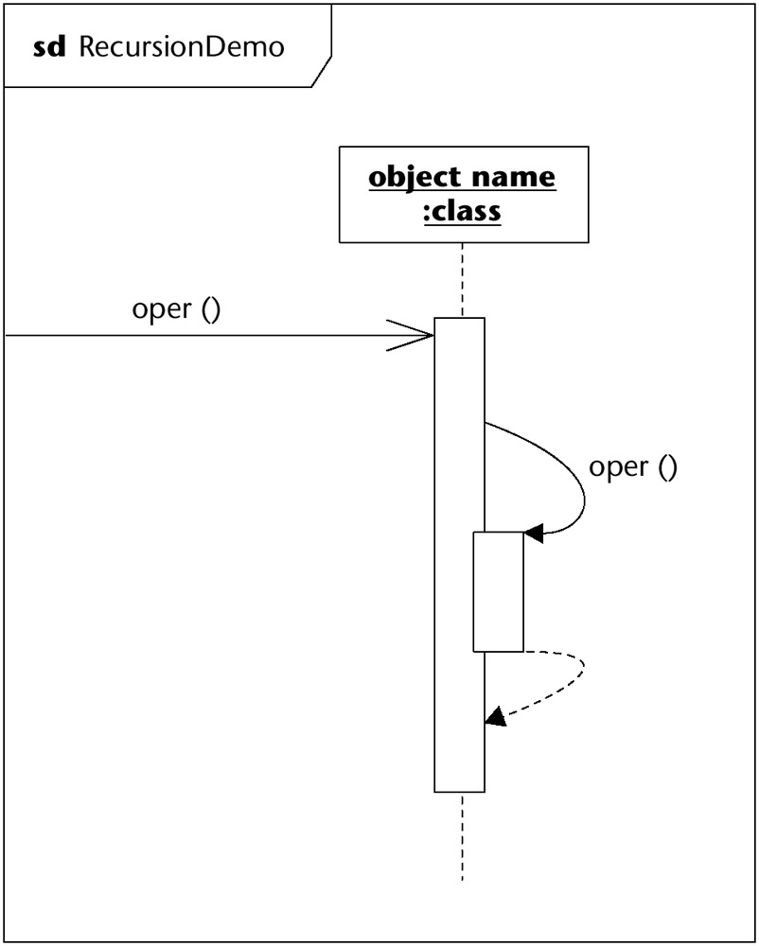
Recursion
Recursion is a technique used in many algorithms. Recursion occurs when an operation calls itself.
The message (when an operation calls itself) is always synchronous and is marked as such in the sequence diagram.
In this case, we are showing the reply message to explicitly show the returns. This reply is often just considered implied by the bottom of the execution occurrence and is left off.

Slide 12
Destruction of an Object
We can use a large ‘X’ at the end of a lifeline to indicate the destruction of an object.
The destruction of an object frees up system resources.
object
object

Slide 13
Fragments
Messages can be grouped in a combined fragment with a keyword.
sd name
:object
:object
:object
Keyword

Slide 14
Combined Fragment Keywords
Keyword | Meaning
alt | Alternatives: A choice in which at most one operand’s condition will evaluate to true.
loop | Used to show that a fragment will be executed repeatedly.
opt | Option: A choice in which either this fragment will execute or not.
par | Parallel fragments that execute in parallel
… | …

Slide 15
Loop Fragment
sd name
:object
:object
:object
loop [condition]

Slide 16
Alternative Fragment
sd name
:object
:object
:object
alt
[condition]
[else]

Slide 17
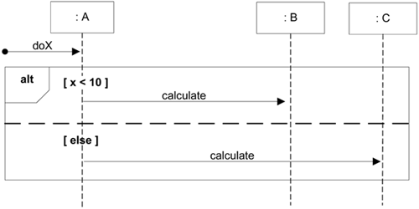
Alternative Fragment Example
sd calculate

Slide 18
Parallel Fragment
sd name
:object
:object
:object
par

Slide 19
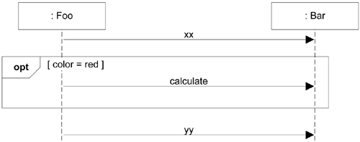
Optional Fragment
sd name

Slide 20
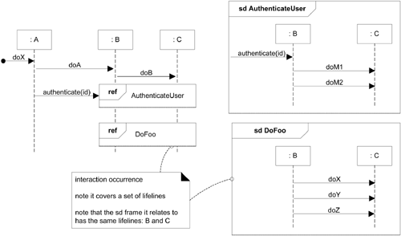
Interaction Fragment
Another way to hide detail in sequence diagram is the use of interaction occurrence – a fragment with ref keyword.

